Slide 1
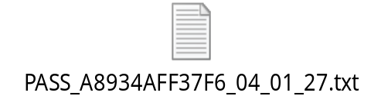
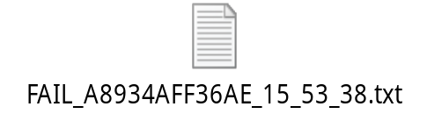


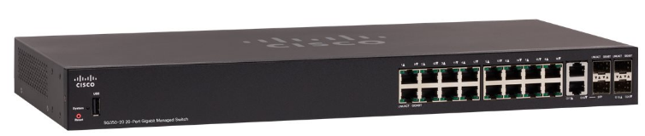
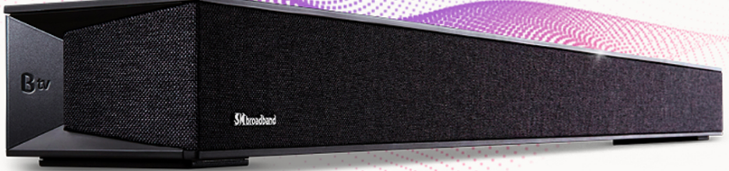
Flowchart diagram ON/OFF station
OK Product
- The Computer (Test PC) will run a program, This program creates a HDCP server activity, listens and assigns an IP address to the Device Under Test(DUT).
- When the DUT operates normally, it requests an IP address from DHCP server, which obtains the MAC address information of the DUT and then assigns an IP address to it.
- After the IP assignment is complete, the program will periodically ping to product’s IP address very 5 seconds, if there are 3 consecutive ping failures, it will report FAIL…
NG Product
Computer
(TEST PC)
DHCP Server
Program ON/OFF 10times
ON 10mins/ OFF 30s
SWITCH (24 Port)
…
DUT1- MAC
(BFX-UA300)
DUT2-MAC
(BFX-UA300)
DUT3-MAC
(BFX-UA300)
DUT4-MAC
(BFX-UA300)
DUT …
(BFX-UA300)

